Slide 1
Bogart Annuity Calculator
TP4F Preparer Page

Slide 2
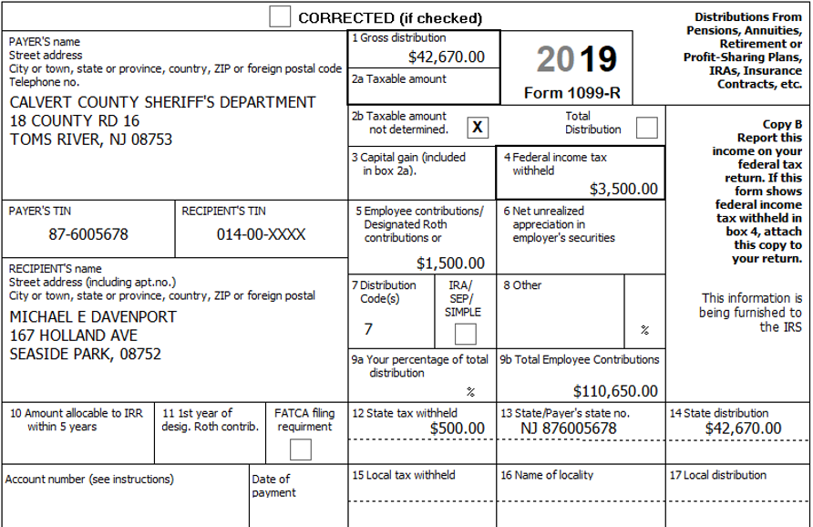
Sample 1099-R for a Pension Distribution

Slide 3
Taxable Amount of 1099-R Distribution
If you made after-tax contributions to a retirement plan, IRS allows amount of distribution attributable to those previously taxed contributions to be excluded from tax in year of distribution
If Box 2a on 1099-R is less than Box 1, the pension custodian has already calculated excludable amount and put the remaining taxable amount in Box 2a
Usually puts excludable amount in Box 5
Box 5 + Box 2a = Box 1

Slide 4
Counselor Determining Taxable Amount of 1099-R Distribution
If Box 2a is blank, counselor must calculate excludable amount using Simplified General Rule
Excludable amount is calculated by dividing your after-tax contributions (cost) by the total number of anticipated monthly payments
Gather information needed to do calculation from taxpayer and 1099-R
Date pension began (taxpayer)

Slide 5
Counselor Determining Taxable Amount of 1099-R Distribution
cont’d
Whether pension is a joint and survivor annuity (taxpayer)
Total employee contribution to retirement plan (1099-R Box 9b)
Annuitant’s birth date (taxpayer)
Also spouse’s birth date, if joint and survivor annuity (taxpayer)
Gross distribution for the tax year (1099-R Box 1)
Whether pension is a disability pension (1099-R Box 7 code = 3)
Whether Public Safety Officer (PSO) health insurance premiums are taken out of pension (taxpayer, 1099-R Box 5)

Slide 6
Use Bogart Annuity Calculator to Determine Taxable Amount of 1099-R Distribution
Recommended way to determine taxable amount of 1099-R distribution is to use the Bogart Annuity calculator
Link on TaxPrep4Free (TP4F) Preparer page
Video tour explaining how to use calculator is at top of calculator page
Enter required data into yellow fields and calculator does the rest
Results from Bogart Annuity calculator can then be entered into TSO
Print results from calculator for Quality Reviewer and for taxpayer records
Information can then be used for following years

Slide 7
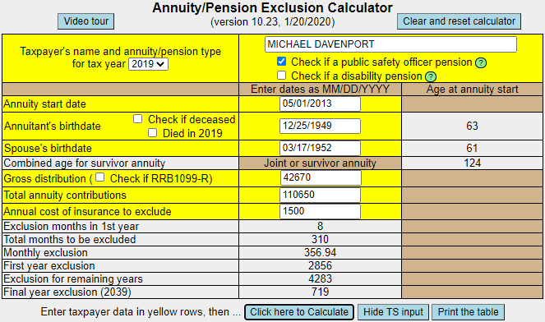
Bogart Annuity Calculator – Part 1
PSO pension
Date pension began
Disability pension
Birthdate of person
receiving pension
Spouse’s birthdate
if joint and survivor
annuity
1099-R Box 1
1099-R Box 9b
1099-R Box 5
Calculated

Slide 8
Information on Part 1 of Bogart Annuity Calculator
Only enter spouse’s birthdate if joint and survivor annuity
If you check PSO pension, calculator will ask for annual cost of insurance to exclude
If you check disability pension, calculator will ask for earliest retirement age
Contributions are not recovered until the minimum retirement age is reached
Based on IRS tables, calculator determines that contributions must be excluded over 310 months
Total contributions $110,650 divided by 310 months = $356.94 monthly exclusion
First year exclusion amount (starting in May) 8 months X $356.94 = $2,856
Next 25 years exclusion amount 12 months X $356.94 = $4,283.28 X 25 = $107,082
Final year exclusion amount Remaining 2 months X $356.94 = $714
310 months $110,650

Slide 9
Special Case When Using Bogart Annuity Calculator
Joint and survivor pension, but primary annuitant dies before beginning to receive pension
At a later date, spouse starts to receive benefits from the pension
Must use spouse’s date of birth & date when spouse started receiving pension when using the Bogart Annuity calculator (instead of dates for primary annuitant)
Notes:
9

Slide 10
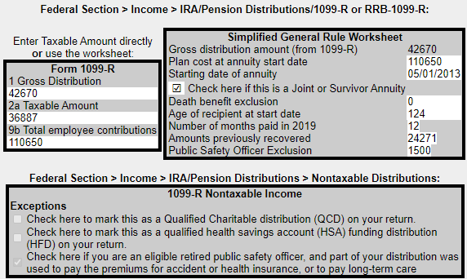
Bogart Annuity Calculator – Part 2
Can enter this info directly onto 1099-R screen
(see slides 14 and 15)
Can enter this info
onto Simplified
Method Work-
sheet screen
(see slides 16 and
17)
Enter on Non-
Taxable Income
Screen (see
slides 19 and 20)

Slide 11
Information on Part 2 of Bogart Annuity Calculator Results
Two methods of entering Bogart results into TSO
Enter info from box on left side of Bogart screen directly into the 1099-R screen, using numbers shown in Bogart box
Enter info from box on right side of Bogart screen into the TSO Simplified Worksheet screen
This method allows TSO to carryforward pension data to next year’s return (if taxpayer signs consent form)

Slide 12
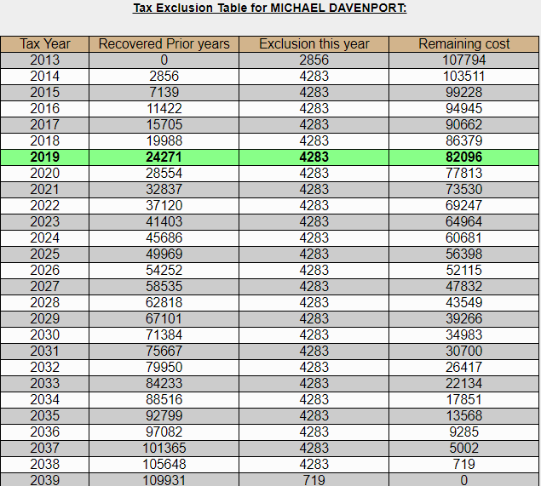
Bogart Annuity Calculator – Part 3

Slide 13
Information on Part 3 of Bogart Annuity Calculator Results
This chart shows the following amounts for each year of expected pension payments:
How much of employee contributions have been recovered tax free in prior years
Total amounts excluded from taxable pension income in prior years
How much can be excluded for that year
How much is still to be recovered
This page can be used for each coming year to determine the taxable amount for Box 2a, without having to use the Bogart calculator each year
Printout should always be put in taxpayer envelope for use by next year’s counselor

Slide 14
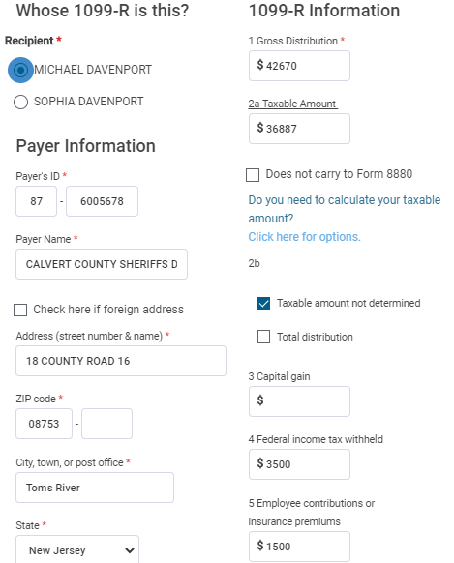
TSO - Entering Bogart Data from Part 2 Left Side Box (Slide 10) Federal Section>Income> IRA/Pension Distributions >Add or Edit a 1099-R
Gross distribution
See slide 10
left side box
Taxable amount
PSO health insurance

Slide 15
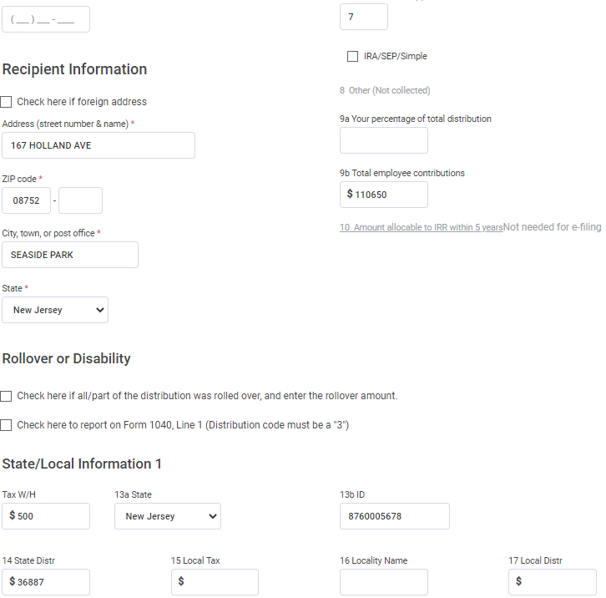
TSO – Entering Bogart Data from Part 2 Left Side Box (Slide 10) Federal Section>Income> IRA/Pension Distributions>Add or Edit a 1099-R
cont’d
Total employee contributions

Slide 16
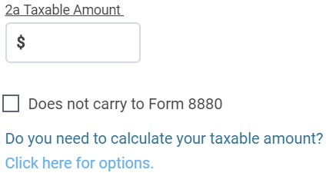
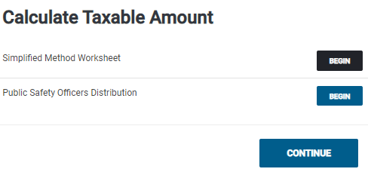
TSO – Entering Bogart Data from Part 2 Right Side Box (Slide 10) Federal Section>Income> IRA/Pension Distributions >Add or Edit a 1099-R>Options
1099-R screen
Includes PSO exclusion
Use for PSO exclusion if
taxable amount is given
in 1099-R Box 2a

Slide 17
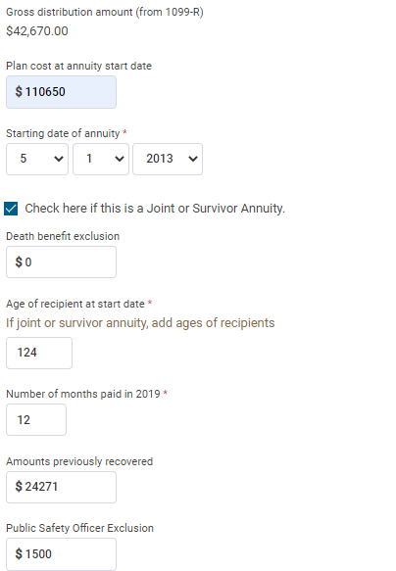
TSO – Entering Bogart Data from Part 2 Right Side Box (Slide 10) Federal Section>Income> IRA/Pension Distributions >Add or Edit a 1099R>Options> Simplified Method Worksheet
See slide 10
right side box

Slide 18
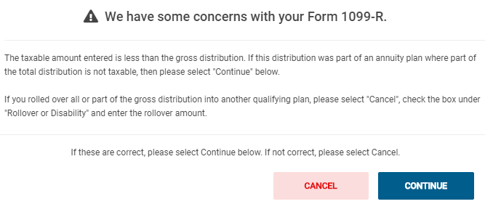
TSO – Warning about Form 1099-R
TSO displays when taxable amount is less than gross distribution. In Davenport case, just click Continue

Slide 19
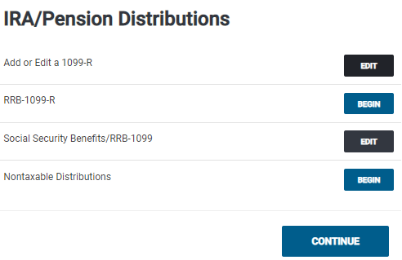
TSO – Entering Reason for Nontaxable Portion of 1099-R Federal Section>Income>IRA/Pension Distributions

Slide 20
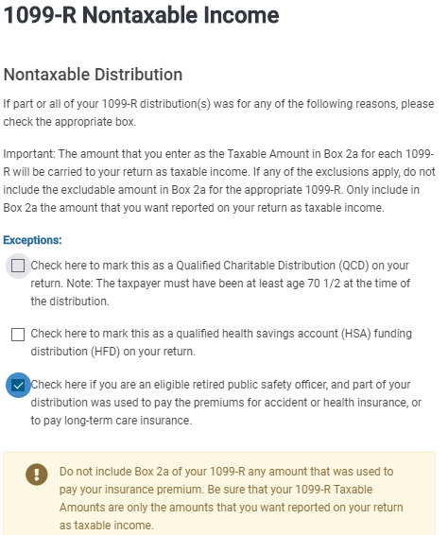
TSO – Entering Reason for Nontaxable Portion of 1099-R Federal Section>Income> IRA/Pension Distributions >Nontaxable Distributions
See slide 10
bottom box

Slide 21
NJ Excludable Pension Amounts on NJ Checklist
Taxable amount of pension from Box 2a flows through to NJ 1040 Line 20a
Excludable amount of pension due to after-tax pension contributions must be manually entered on NJ 1040 20b
Use excludable amount shown on Tax Exclusion Table in Bogart Annuity Calculator results (see slide 12)
Enter as Adjustment to Line 20b on NJ Checklist in Income Subject to Tax section
Don’t forget to also do NJ Checklist entries for the PSO health insurance premiums
Refer to NJ Special Handling document for details on these entries

Slide 22
Excludable Pension Amount From Bogart Annuity Calculator on NJ Checklist
Excludable pension
amount added to Line 20b
Don’t forget to also do NJ Checklist entries for PSO health insurance premiums; refer
to NJ Special Handling document for details

